Slide 1
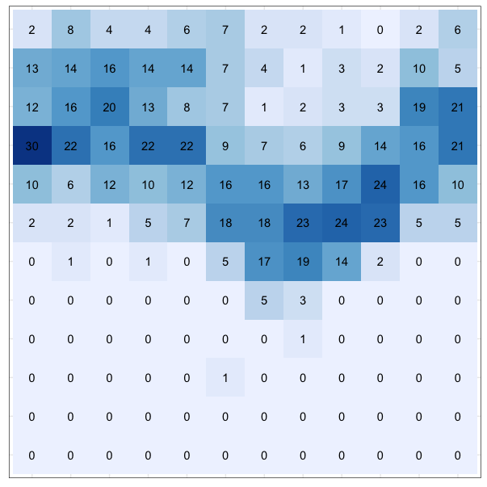
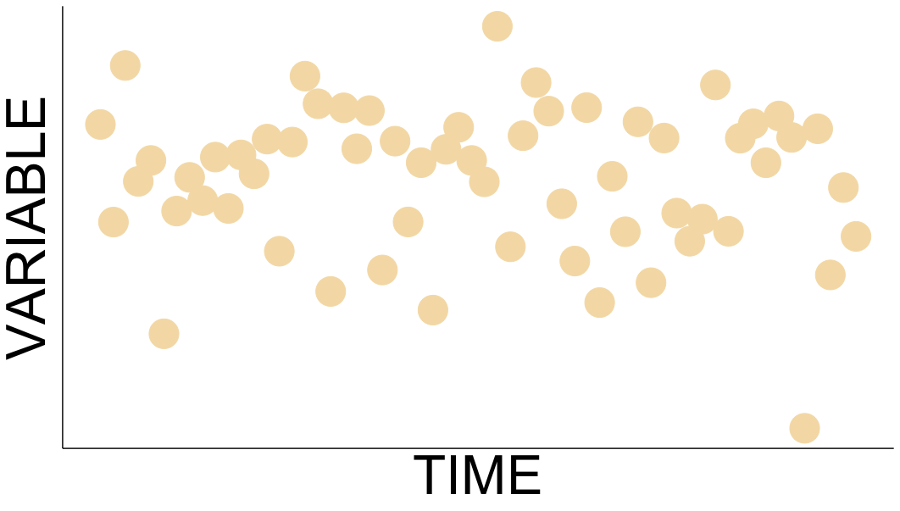
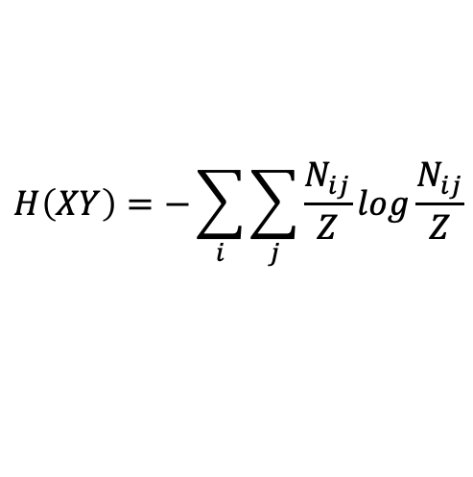
outline
what is environmental predictability?
how is it relevant?
  generally
  for Bay-Delta science more broadly
  examples
illustrating predictability
  (time series)
  heat map
how to quantify environmental predictability
  Colwell’s C + M = P
$$H\left(XY\right)=−\sum_{i}{\sum_{j}{\frac{N_{ij}}{Z}log\frac{N_{ij}}{Z}}}$$
Notes:
There are MANY ways to measure or quantify "predictability", but I'm going to focus on cyclical phenomena. In other words, variables that might reasonably be expected to exhibit some kind of recurring pattern on a regular time scale or period.

Slide 2
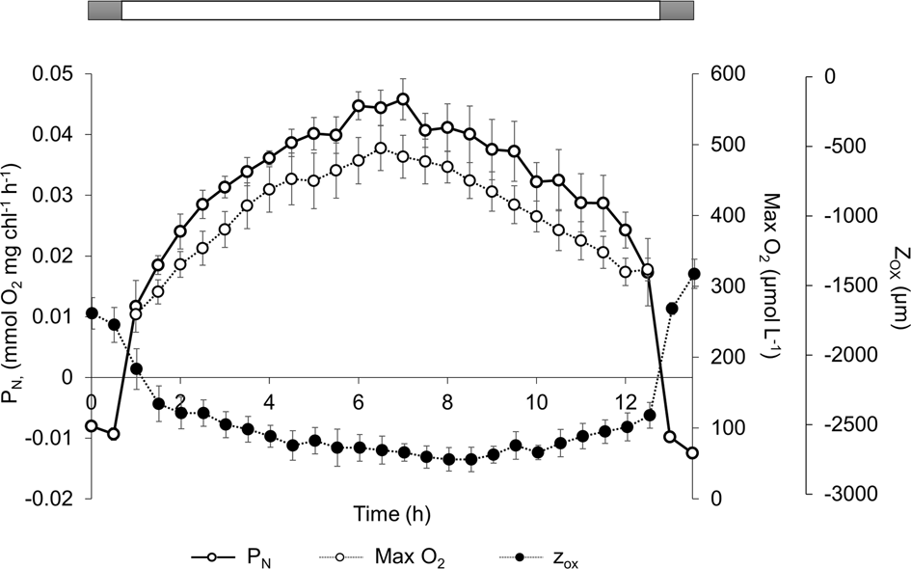
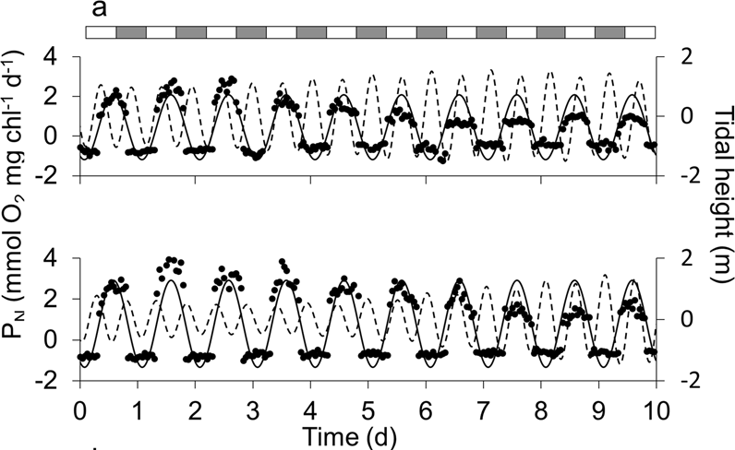
what is environmental predictability?
temporal periodicity: seasonality
reliable—or unreliable!—recurrence of these patterns is what I’m referring to as predictability
periodical physical or biological data with a known period (eg yearly or daily)
Tonkin et al. 2017: “we define predictability as the regularity of recurrence of the within cycle (e.g., annual) distribution of events across multiple cycles”
Colwell (1974) argues that predictability (P) has two separable components, constancy (C) and contingency (M)
Notes:
There are MANY ways to measure or quantify "predictability", but I'm going to focus on cyclical phenomena. In other words, variables that might reasonably be expected to exhibit some kind of recurring pattern on a regular time scale or period.
Primary productivity in the photic zone (and [oxygen]) of intertidal sediments (Fig 1 top, Fig 3 bottom, Haro et al. 2019 DOI 10.1038/s41598-019-49971-8)
environmental heterogeneity…temporal periodicity is a central feature of ecosystems everywhere and fluctuations within these periods—days, lunar phases, years and more!--at least partially explains life history adaptations, physiological rhythms, latitudinal diversity gradients, and community structure
PREDICTABILTY can be maximal (ie P=1) through complete constancy, complete contingency or a combination of the two…
constant over time (temperature in the deep sea)
regular change over time (seasonal environments may be variable but predictable—California summers are warm and dry; winters are cool and wet)
temporal autocorrelation (conditions now are closely correlated with conditions in the future: color of the environmental noise said to be reddened)
data could refer to behavior…period could be weekly (number of persons present at West Sac each day of the week)
top 2 time series: figure 2 from DOI: 10.1007/s12650-019-00586-1 (cropped)
bottom figure: https://climatereanalyzer.org/clim/t2_daily/?dm_id=world

Slide 3
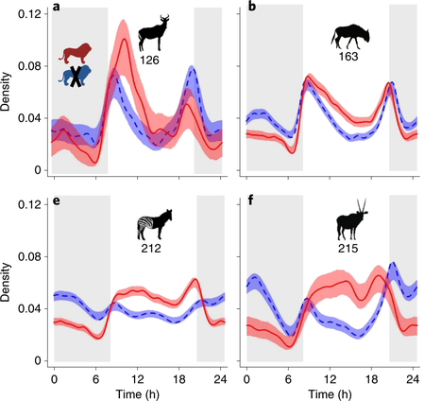
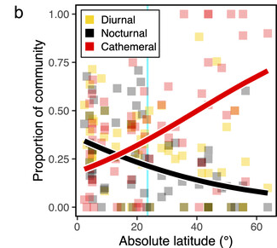
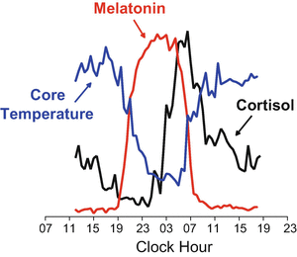
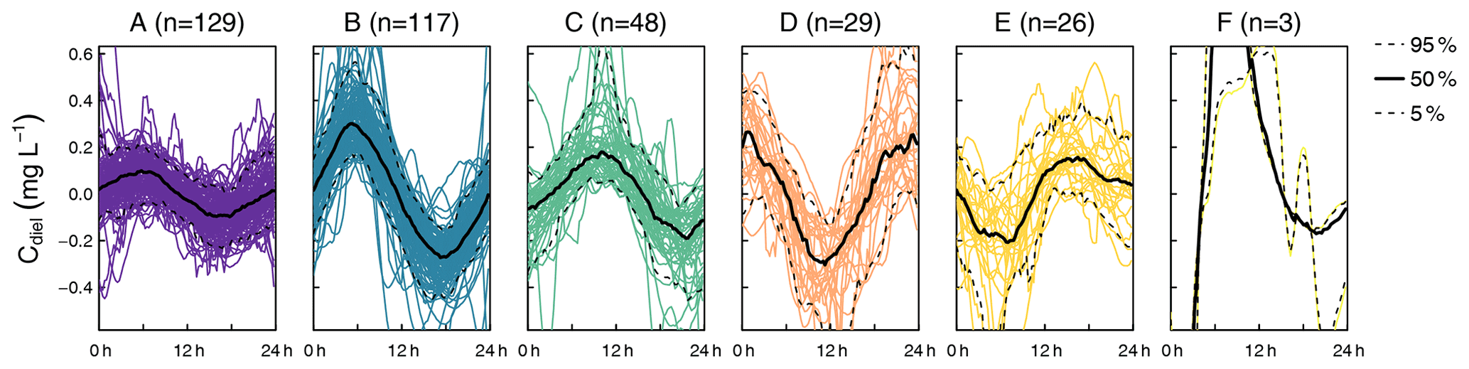
Notes:
Insect diel activity patterns over a latitudinal gradient (Fig 1b Wong 2025 DOI:https://doi.org/10.1098/rsbl.2024.0622)
Circadian rhythms in humans (Fig 13.1, Broussard et al. 2017 in Kumar (ed) Biological Timekeeping…https://doi.org/10.1007/978-81-322-3688-7_13)
Predation risk constrains diel behavior (Fig 3 partial, Veldhuis et al. 2020 https://doi.org/10.1038/s41559-020-1218-2)
Diel patterns in nitrate concentration in the river Elz (sw Germany) (Fig 2, Greiwe et al. 2021 https://doi.org/10.5194/bg-18-4705-2021)

Slide 4
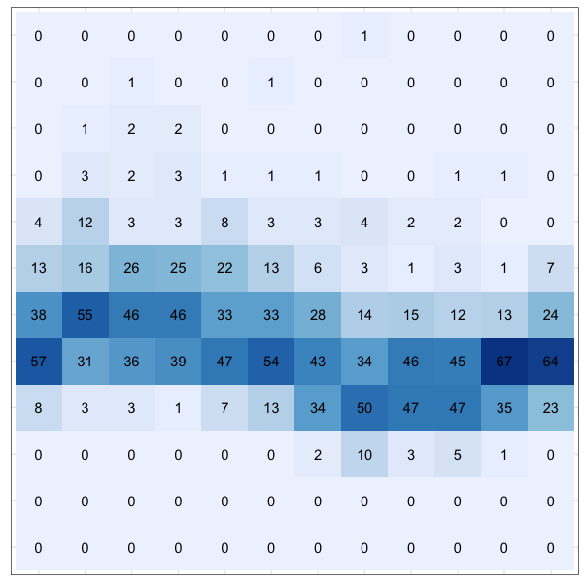
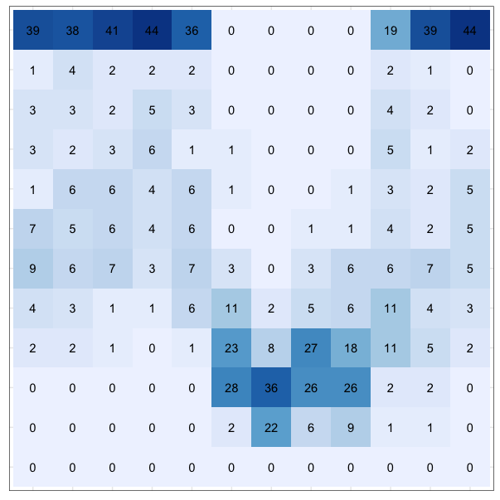
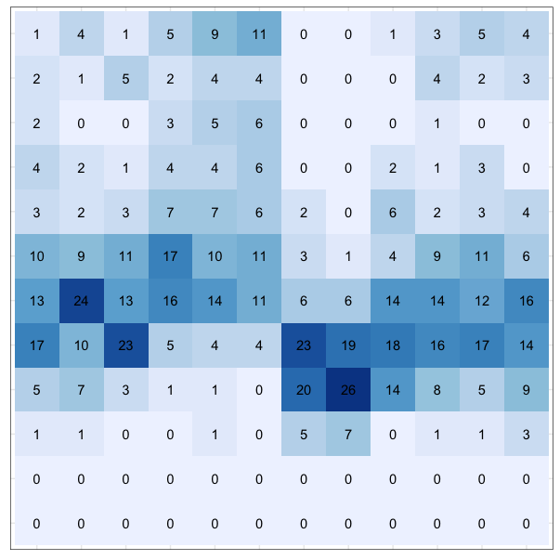
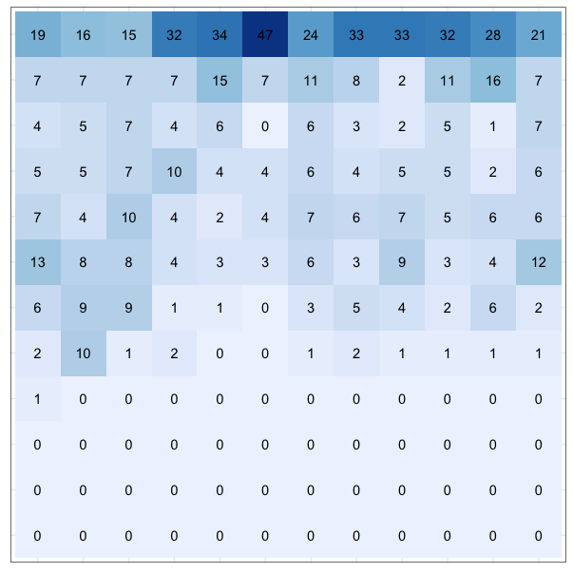
Vilsandi, Estonia 58.38 21.82
Telhara, India 21.03 76.83
Show Low, Arizona 34.26 -110.01
Death Valley, California
36.46 -116.87
Ellesmere Is, Arctic
79.98 -85.93
Which location has the most predictable rainfall? Which one the least?!
Notes:
Please rank

Slide 5
Vilsandi, Estonia 58.38 21.82
Telhara, India 21.03 76.83
Show Low, Arizona 34.26 -110.01
Death Valley, California
36.46 -116.87
Ellesmere Is, Arctic
79.98 -85.93
C | 0.2506 | 0.5565 | 0.3589 | 0.6172 | 0.8231
M | 0.0816 | 0.1816 | 0.0895 | 0.0422 | 0.0510
P | 0.3322 | 0.7381 | 0.4485 | 0.6593 | 0.8740
5
2
4
3
1

Slide 6
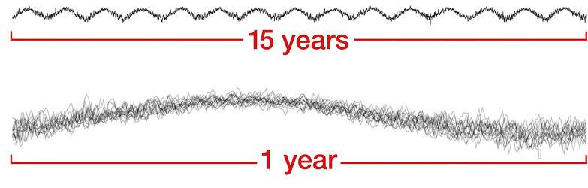
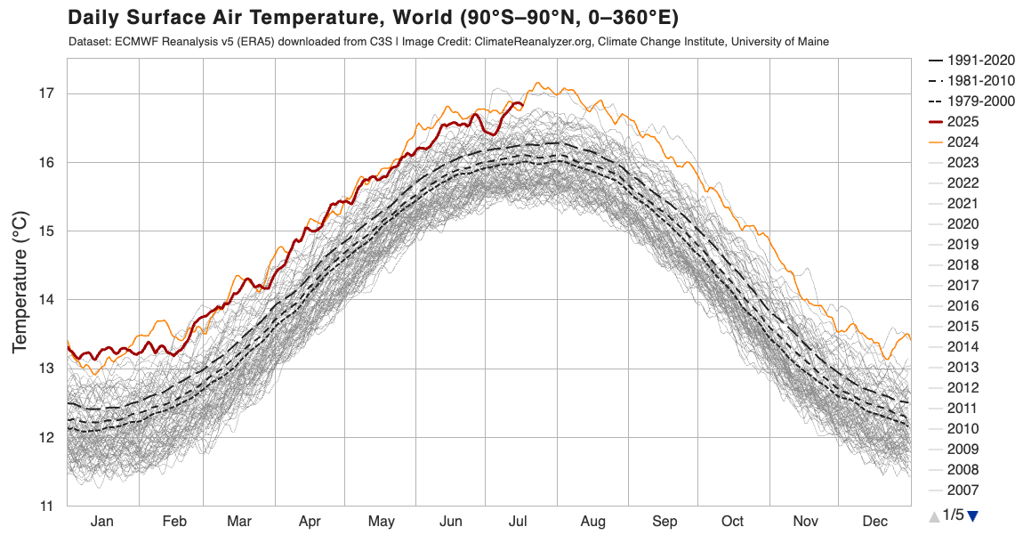
what is environmental predictability?
temporal periodicity: seasonality
the recurrence of these patterns is “predictability”
periodical physical or biological data with a known period (eg yearly or daily)
Tonkin et al. 2017: “we define predictability as the regularity of recurrence of the within cycle (e.g., annual) distribution of events across multiple cycles”
Colwell (1974) argues that predictability (P) has two separable components, constancy (C) and contingency (M)
Notes:
environmental heterogeneity…temporal periodicity is a central feature of ecosystems everywhere and fluctuations within these periods—days, lunar phases, years and more!--at least partially explains life history adaptations, physiological rhythms, latitudinal diversity gradients, and community structure
PREDICTABILTY can be maximal (ie P=1) through complete constancy, complete contingency or a combination of the two…
constant over time (temperature in the deep sea)
regular change over time (seasonal environments may be variable but predictable—California summers are warm and dry; winters are cool and wet)
temporal autocorrelation (conditions now are closely correlated with conditions in the future: color of the environmental noise said to be reddened)
data could refer to behavior…period could be weekly (number of persons present at West Sac each day of the week)
top 2 time series: figure 2 from DOI: 10.1007/s12650-019-00586-1 (cropped)
bottom figure: https://climatereanalyzer.org/clim/t2_daily/?dm_id=world

Slide 7
 | Tree a
 | I | II | III
ff | 9 | 9 | 9 | P = 1
fl | 0 | 0 | 0 | C = 1
nf | 0 | 0 | 0 | M = 0
 | Tree b
 | I | II | III
ff | 9 | 0 | 0 | P = 1
fl | 0 | 0 | 9 | C = 0
nf | 0 | 9 | 0 | M = 1
 | Tree c
 | I | II | III
ff | 9 | 0 | 0 | P = 1
fl | 0 | 9 | 9 | C = .42
nf | 0 | 0 | 0 | M = .58
Predictability (P) has two separable components,
constancy (C) and contingency (M).
 | Tree g
 | I | II | III
ff | 3 | 3 | 3 | P = 0
fl | 3 | 3 | 3 | C = 0
nf | 3 | 3 | 3 | M = 0
adapted from Colwell 1974, Table 1
Notes:
Tree a shows data on its phenological status over 9 years. In every season (I-III), for every year, it's always ff--fruiting and flowering. Perfect C constancy makes predictability easy!
Tree b shows the same kind of data, but this tree is in a different state each season (C=0), but contingency (M) the status is different every season but the pattern is invariant across all years. Again Predictability is easy.
Tree c, perhaps growing in different habitat, shows a 3rd pattern: here C is improved over Tree b but lower than Tree a. P is the sum of C + M
The pattern is perfectly predictable for trees a, b & c—if we know the season, we know the phenological state of the tree.
The opposite is true for Tree g—all states are equally likely at any season.
perfect C: Tree a…complete constancy, across all seasons and across all years
perfect M: Tree b…complete contingency, the state is different for each season, but the pattern is identical year after year
perfect P through a combination of C + M: Tree c, here the pattern is the same for all years but some phenological states are common to more than one season.

Slide 8
 | Tree a
 | I | II | III
ff | 9 | 9 | 9 | P = 1
fl | 0 | 0 | 0 | C = 1
nf | 0 | 0 | 0 | M = 0
 | Tree b
 | I | II | III
ff | 9 | 0 | 0 | P = 1
fl | 0 | 0 | 9 | C = 0
nf | 0 | 9 | 0 | M = 1
 | Tree d
 | I | II | III
ff | 1 | 1 | 1 | P = .23
fl | 2 | 2 | 2 | C = .23
nf | 6 | 6 | 6 | M = 0
 | Tree e
 | I | II | III
ff | 6 | 0 | 3 | P = .61
fl | 3 | 0 | 6 | C = 0
nf | 0 | 9 | 0 | M = .61
 | Tree g
 | I | II | III
ff | 3 | 3 | 3 | P = 0
fl | 3 | 3 | 3 | C = 0
nf | 3 | 3 | 3 | M = 0
adapted from Colwell 1974, Table 1
Notes:
CONTINGENCY is low when the probability of occurrence for each state is independent of the season (trees a, d & g). In other words, when the columns of the data matrix are homogenous.
CONSTANCY is minimal when the state of the tree fluctuates to the greatest degree possible during the year. Note that the row totals are equal (trees b, e & g)

Slide 9
 | Tree a
 | I | II | III
ff | 9 | 9 | 9 | P = 1
fl | 0 | 0 | 0 | C = 1
nf | 0 | 0 | 0 | M = 0
 | Tree b
 | I | II | III
ff | 9 | 0 | 0 | P = 1
fl | 0 | 0 | 9 | C = 0
nf | 0 | 9 | 0 | M = 1
 | Tree c
 | I | II | III
ff | 9 | 0 | 0 | P = 1
fl | 0 | 9 | 9 | C = .42
nf | 0 | 0 | 0 | M = .58
 | Tree d
 | I | II | III
ff | 1 | 1 | 1 | P = .23
fl | 2 | 2 | 2 | C = .23
nf | 6 | 6 | 6 | M = 0
 | Tree e
 | I | II | III
ff | 6 | 0 | 3 | P = .61
fl | 3 | 0 | 6 | C = 0
nf | 0 | 9 | 0 | M = .61
 | Tree f
 | I | II | III
ff | 0 | 1 | 4 | P = .29
fl | 1 | 3 | 3 | C = .10
nf | 8 | 5 | 2 | M = .19
 | Tree g
 | I | II | III
ff | 3 | 3 | 3 | P = 0
fl | 3 | 3 | 3 | C = 0
nf | 3 | 3 | 3 | M = 0
adapted from Colwell 1974, Table 1
Notes:
Trees d, e, and f show that constancy and contingency are separable for intermediate degrees of predictability.
CONTINGENCY is low when the probability of occurrence for each state is independent of the season (trees a, d & g). In other words, when the columns of the data matrix are homogenous.
CONSTANCY is minimal when the state of the tree fluctuates to the greatest degree possible during the year. Note that the row totals are equal (trees b, e & g)

Slide 10







 | Tree a
 | I | II | III
ff | 9 | 9 | 9 | P = 1
fl | 0 | 0 | 0 | C = 1
nf | 0 | 0 | 0 | M = 0
 | Tree b
 | I | II | III
ff | 9 | 0 | 0 | P = 1
fl | 0 | 0 | 9 | C = 0
nf | 0 | 9 | 0 | M = 1
 | Tree c
 | I | II | III
ff | 9 | 0 | 0 | P = 1
fl | 0 | 9 | 9 | C = .42
nf | 0 | 0 | 0 | M = .58
 | Tree d
 | I | II | III
ff | 1 | 1 | 1 | P = .23
fl | 2 | 2 | 2 | C = .23
nf | 6 | 6 | 6 | M = 0
 | Tree e
 | I | II | III
ff | 6 | 0 | 3 | P = .61
fl | 3 | 0 | 6 | C = 0
nf | 0 | 9 | 0 | M = .61
 | Tree f
 | I | II | III
ff | 0 | 1 | 4 | P = .29
fl | 1 | 3 | 3 | C = .10
nf | 8 | 5 | 2 | M = .19
 | Tree g
 | I | II | III
ff | 3 | 3 | 3 | P = 0
fl | 3 | 3 | 3 | C = 0
nf | 3 | 3 | 3 | M = 0
adapted from Colwell 1974, Table 1
Notes:
“Data” from multiple individual trees (a-g), growing in a variety of habitats, collected over 9 years
Columns represent seasons (eg I Jan-Apr, II May-Aug, III Sep-Dec);
rows represent different phenological states: ff fruiting and flowering, fl flowering only, nf no flowering or fruiting
But the heat map is a distraction!

Slide 11
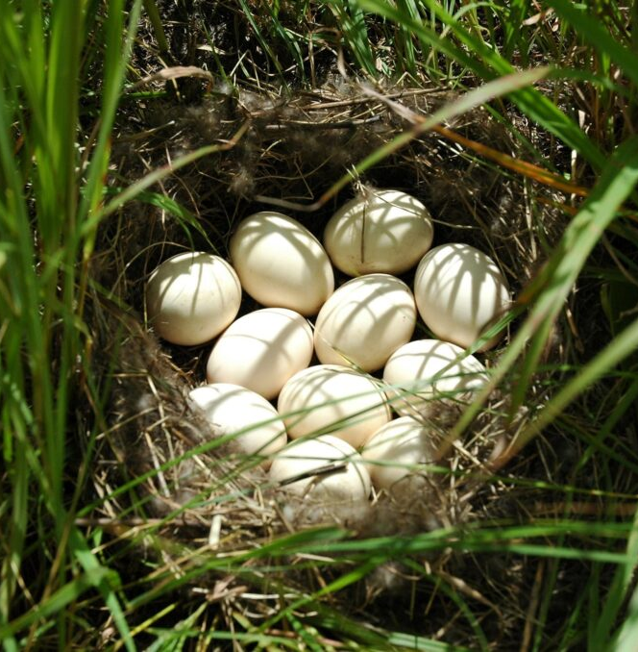
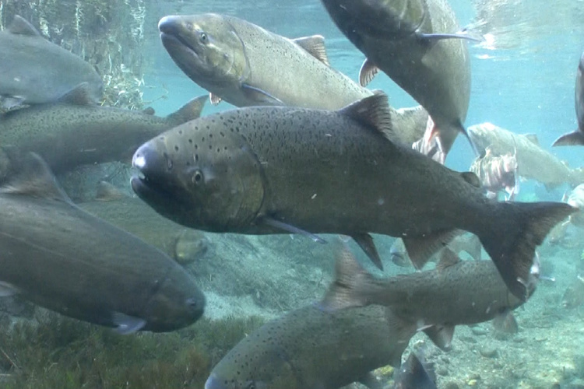
how is env pred relevant?
ecology and evolution
conservation
DWR
  water management
  environmental quality
  functional ecology
  restoration
examples
  hydrography
  salmon habitat
  prey resources
  restoration effects
  climate change
Notes:
ecol & evol: how many eggs to lay? selecting a foraging strategy… life history diversity…
conservation: population persistence (MVP); phenotypic diversity; effect on invasion biol
DWR: water management (how do mgmt decisions affect predictability of CV & Delta environments?)
environ qual (predictability of key habitat? climate change?)
functional ecol (env pred affects community structure—inform resource & spp mgmt)
restoration (restoration may affect env pred: compare to established habitat and historical conditions)
examples: how does the hydrography vary upstream vs downstream of a water diversion?
how does the spawning habitat for salmon compare across tributaries?
how predictable is diel zooplankton density in DS habitat from one year to the next?
how might salt marsh restoration affect the predictability of DOM?
duck eggs, Ducks Unlimited; spring-run Chinook, USFWS (Michael Humling)

Slide 12
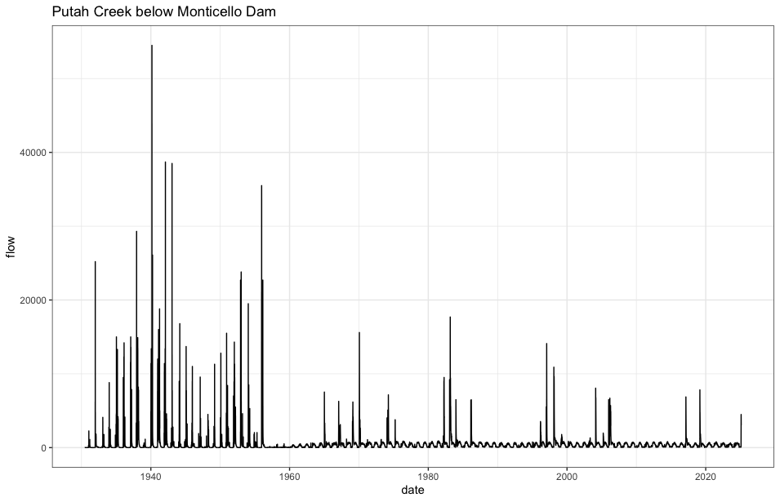
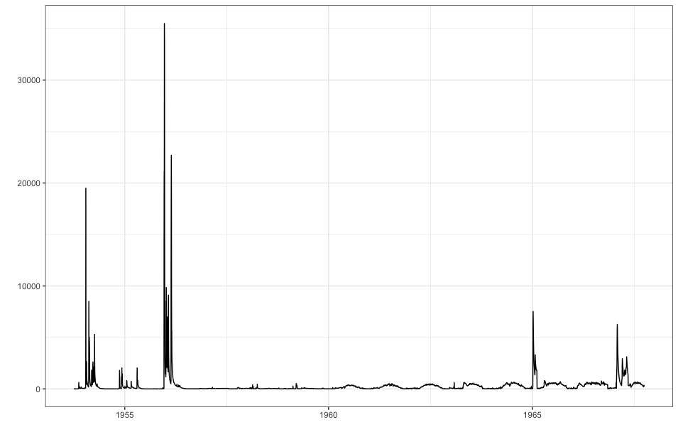
WY 1953 – 1967
Monticello Dam
1956
M
C
M
C

Slide 13
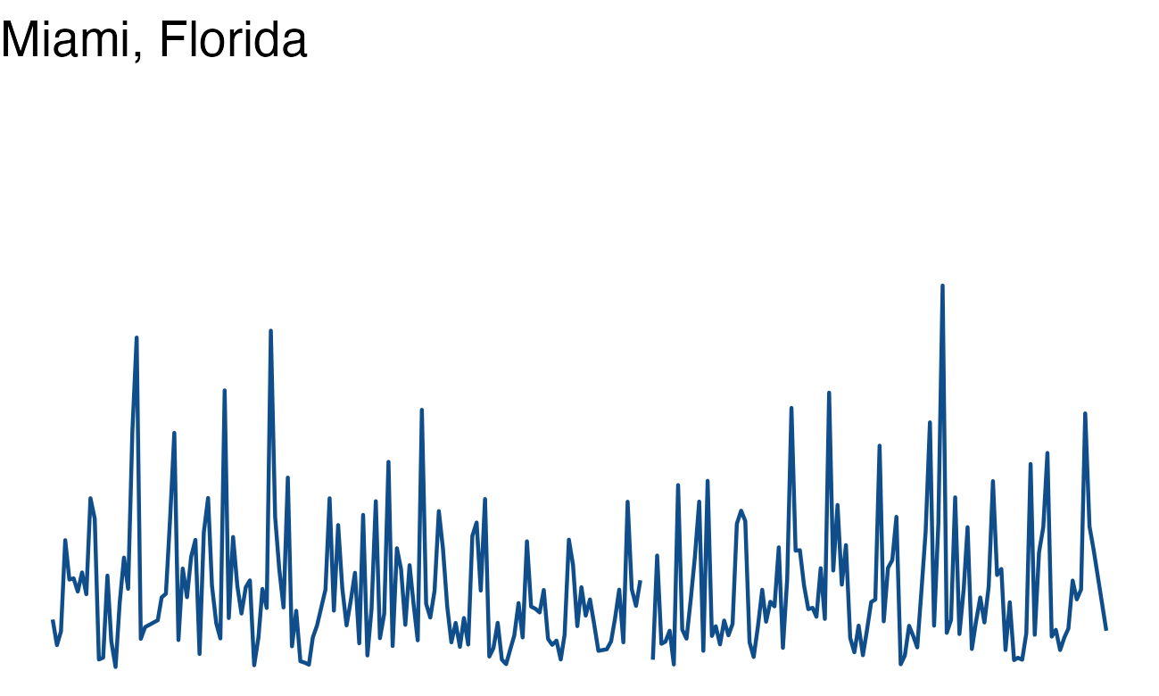
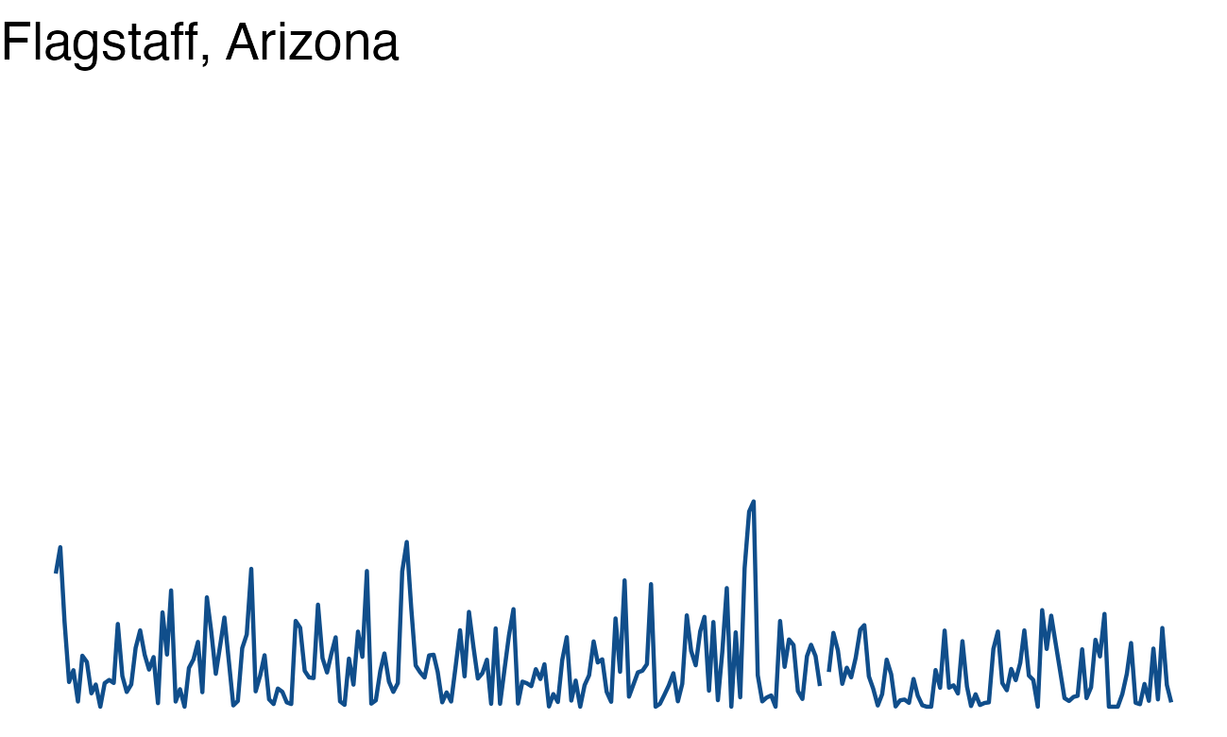
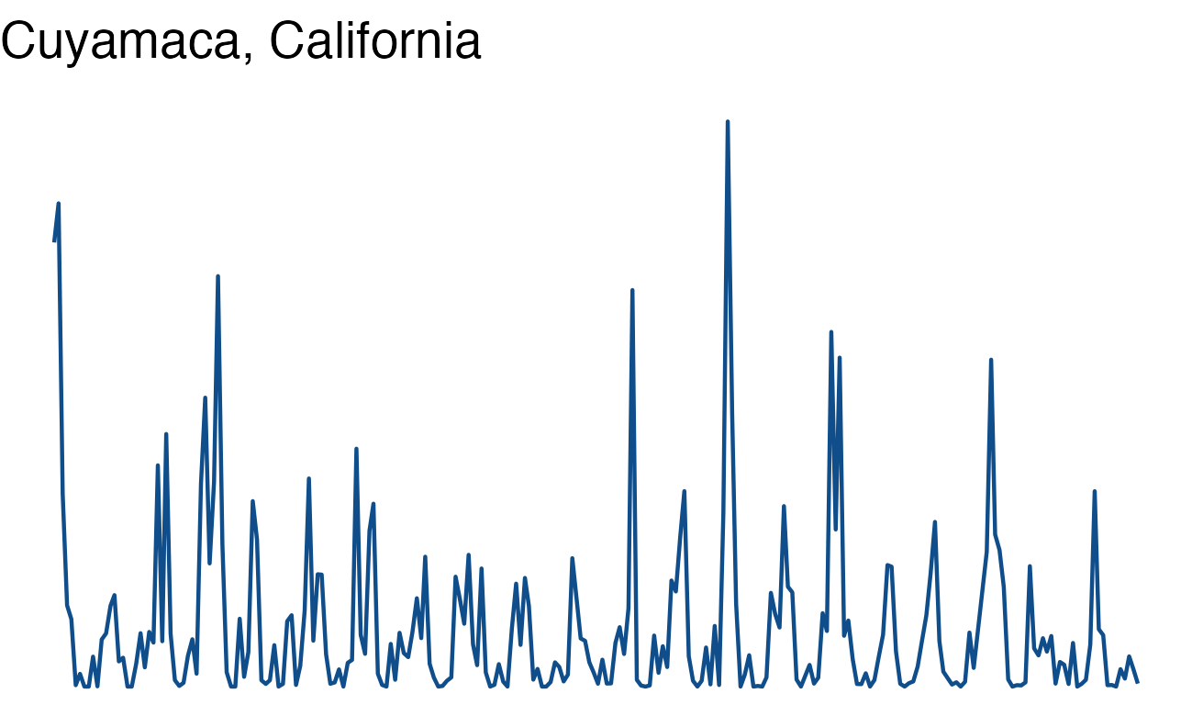
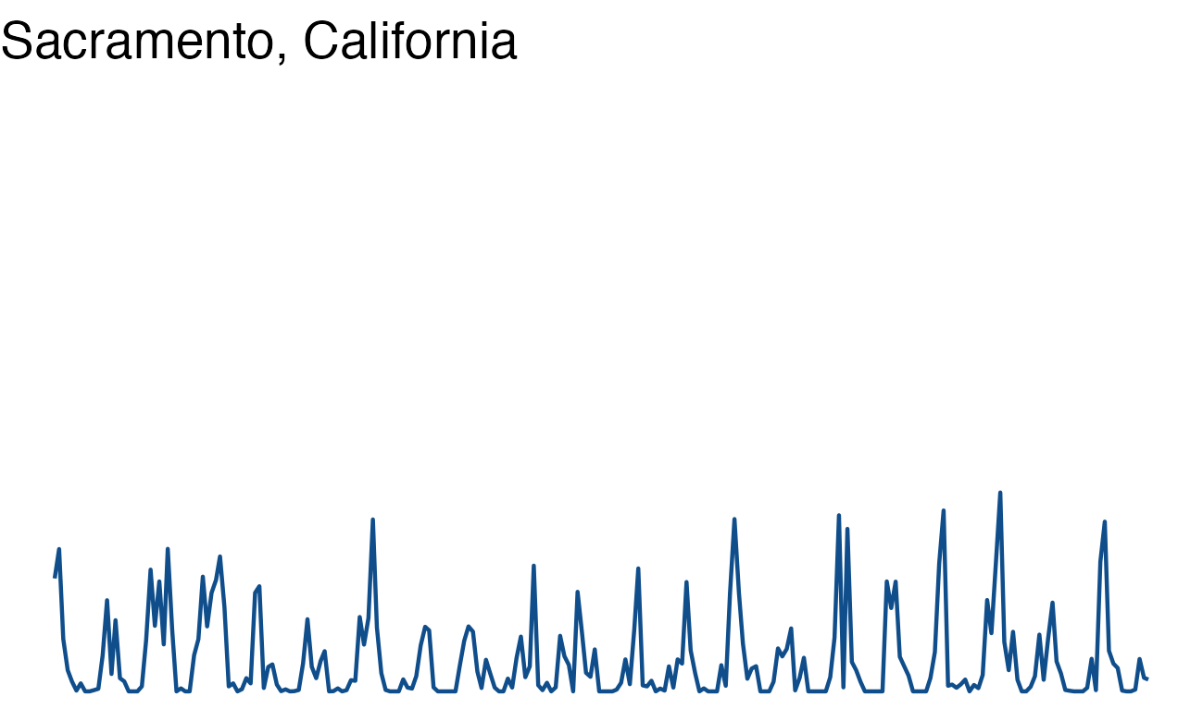
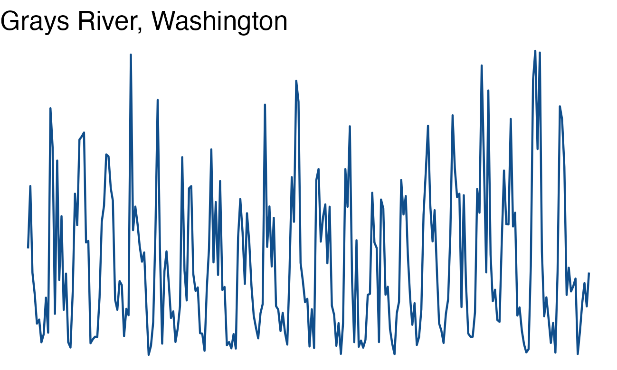
P = .37
C = .25
M = .12
P = .38
C = .26
M = .12
P = .61
C = .49
M = .12
P = .56
C = .37
M = .19
P = .37
C = .10
M = .26
Notes:
All 5 data sets are monthly rainfall 1980-2000
For now, just look at P--we'll talk about C and M shortly.
[animation shows P, C & M starting w the most predictable, Cuyamaca]
A time series is a great way to look at periodic phenomena, at least initially, and there are multiple means of visualizing time series, specifically. However, I’m not going to spend time on this.

Slide 14
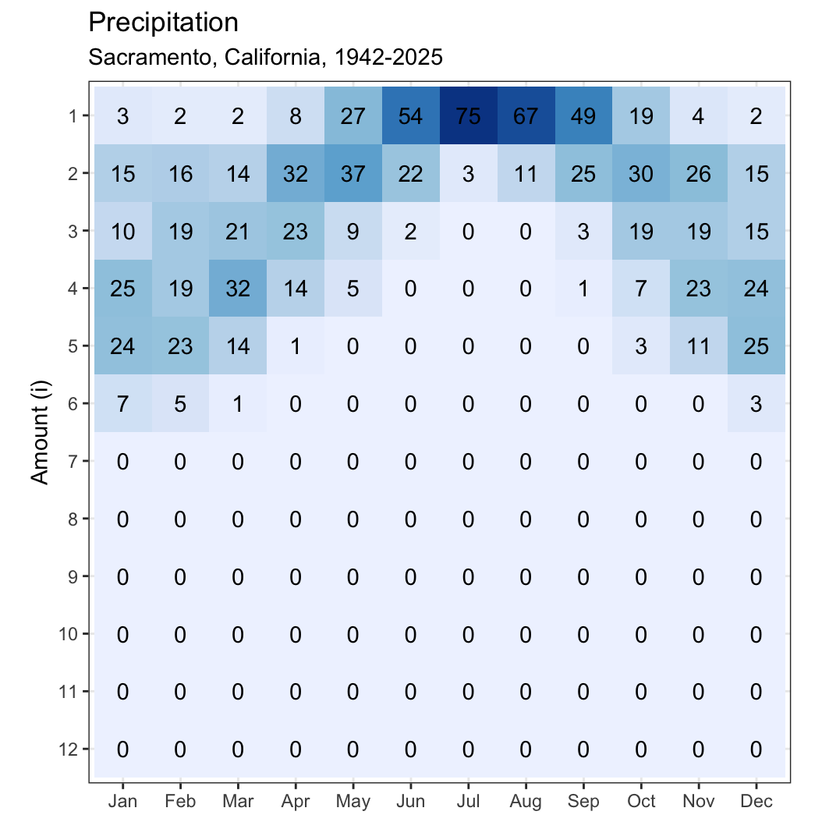
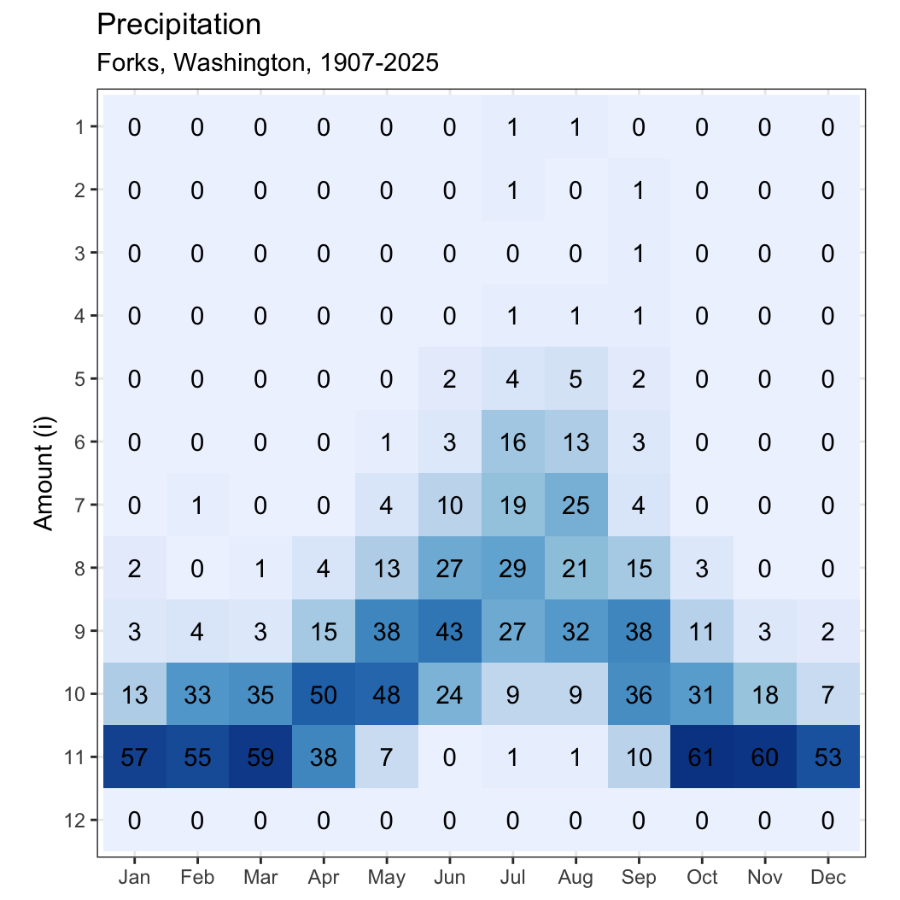
Notes:
As a more sophisticated alternative, I’d like share how you can convert that ts data into a heat map. Here’s the same Sac precip data from the previous slide in heat map form. Note that with data having a fixed lower bound (you can’t have less than 0 rainfall!), the SD is highly correlated with the mean. To compare sites or months, you need to correct for this bias. Here, I’ve used log classes to remove the correlation btwn SD and mean. Obviously, 12 classes of rainfall quantity (i) weren’t necessary to examine the Sacramento data, but this was necessary for wetter areas that might be interesting point of comparison—see these data from western Washington.

Slide 15
how to measure env pred…
two r packages
next steps & applications
envPred
hydrostats
limitations
apply to habitats & distribution ranges key CV & Delta spp
explore application to other time series
expand capabilities of existing packages
suggestions for application
help with r packages

Slide 16
reading
Castillo, Nicole, Juan Diego Gaitán-Espitia, Julian F. Quintero-Galvis, et al. “Small-Scale Geographic Differences in Multiple-Driver Environmental Variability Can Modulate Contrasting Phenotypic Plasticity despite High Levels of Gene Flow.” Science of The Total Environment 954 (December 2024): 176772. https://doi.org/10.1016/j.scitotenv.2024.176772.
Caswell, Hal, and Joel E. Cohen. “Red, White and Blue: Environmental Variance Spectra and Coexistence in Metapopulations.” Journal of Theoretical Biology 176, no. 2 (1995): 301–16. https://doi.org/10.1006/jtbi.1995.0200.
Colwell, Robert K. “Predictability, Constancy, and Contingency of Periodic Phenomena.” Ecology 55 (1974): 1148–53.
Gasith, Avital, and Vincent H. Resh. “Streams in Mediterranean Climate Regions: Abiotic Influences and Biotic Responses to Predictable Seasonal Events.” Annual Review of Ecology and Systematics 30 (1999): 51–81. https://doi.org/10.1146/annurev.ecolsys.30.1.51.
Jiang, Mingkai, Benjamin S. Felzer, and Dork Sahagian. “Characterizing Predictability of Precipitation Means and Extremes over the Conterminous United States, 1949–2010.” Journal of Climate. Journal of Climate 29, no. 7 (2016): 2621–33. https://doi.org/10.1175/JCLI-D-15-0560.1.
Keyser, Spencer R., Jonathan N. Pauli, Daniel Fink, Volker C. Radeloff, Alex L. Pigot, and Benjamin Zuckerberg. “Seasonality Structures Avian Functional Diversity and Niche Packing Across North America.” Ecology Letters 27, no. 10 (2024): e14521. https://doi.org/10.1111/ele.14521.
Poff, N. LeRoy, and J. David Allan. “Functional Organization of Stream Fish Assemblages in Relation to Hydrological Variability.” Ecology 76, no. 2 (1995): 606–27. https://doi.org/10.2307/1941217.
Riotte-Lambert, Louise, and Jason Matthiopoulos. “Environmental Predictability as a Cause and Consequence of Animal Movement.” Trends in Ecology & Evolution 35, no. 2 (2020): 163–74. https://doi.org/10.1016/j.tree.2019.09.009.
Stearns, Stephen C. “On Measuring Fluctuating Environments: Predictability, Constancy, and Contingency.” Ecology 62, no. 1 (1981): 185–99. https://doi.org/10.2307/1936681.
Tonkin, Jonathan D., Michael T. Bogan, Núria Bonada, Blanca Rios-Touma, and David A. Lytle. “Seasonality and Predictability Shape Temporal Species Diversity.” Ecology 98, no. 5 (2017): 1201–16. https://doi.org/10.1002/ecy.1761.
Tonkin, Jonathan D., David M. Merritt, Julian D. Olden, Lindsay V. Reynolds, and David A. Lytle. “Flow Regime Alteration Degrades Ecological Networks in Riparian Ecosystems.” Nature Ecology & Evolution 2, no. 1 (2018): 86–93. https://doi.org/10.1038/s41559-017-0379-0.
Wieczynski, Daniel J., and David A. Vasseur. “Environmental Fluctuations Promote Intraspecific Diversity and Population Persistence via Inflationary Effects.” Oikos 125, no. 8 (2016): 1173–81. https://doi.org/10.1111/oik.02725.

Slide 17
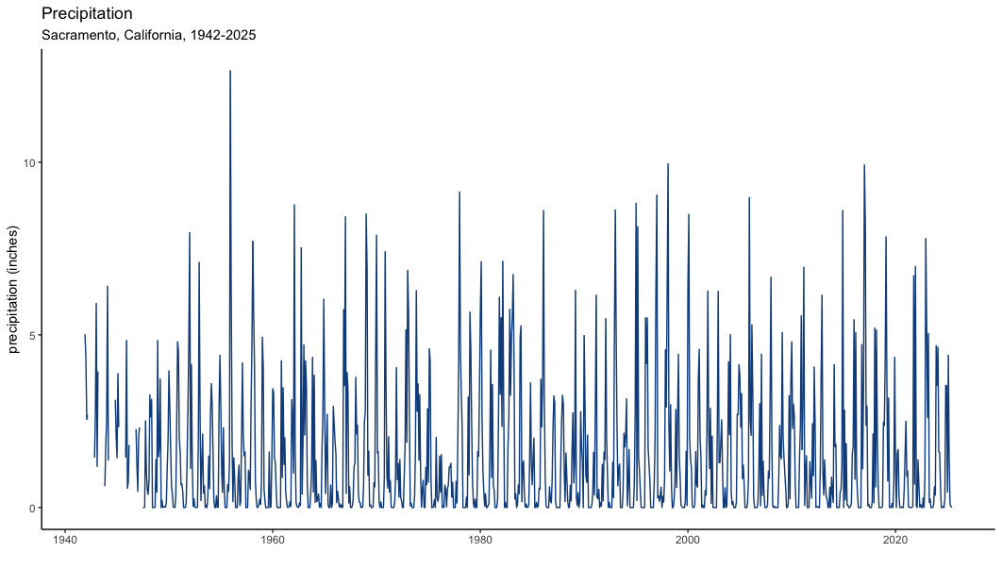
how to look at env pred…
Notes:
A time series is a great way to look at periodic phenomena, at least initially, and there are multiple means of visualizing time series, specifically. However, I’m not going to spend time on this—but maybe we’ll get Ted Swift to give us a ts workshop in the future.

Slide 18
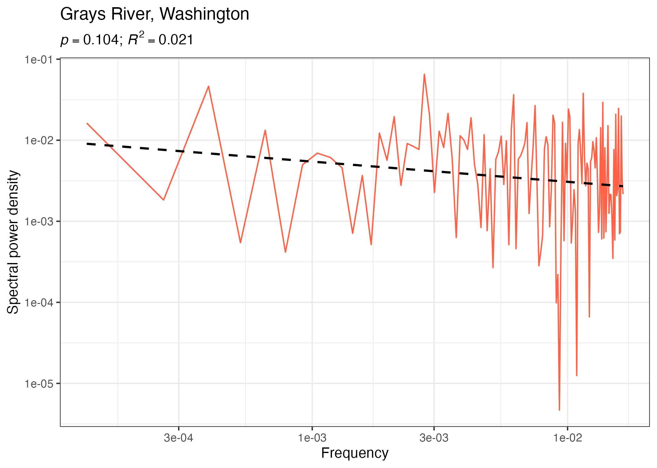
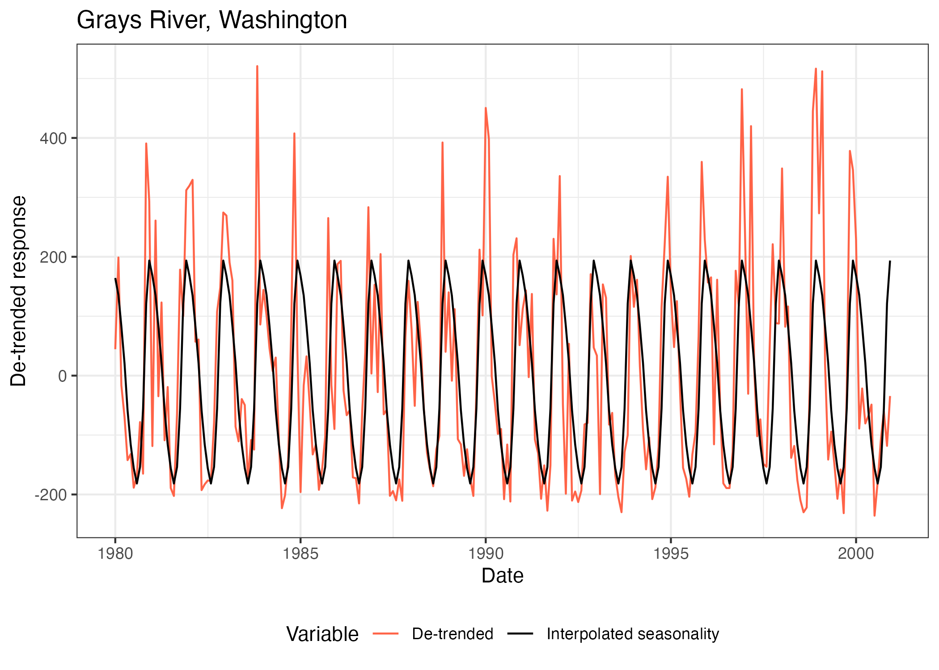

Slide 19
 | Tree a
 | I | II | III
ff | 9 | 9 | 9 | P = 1
fl | 0 | 0 | 0 | C = 1
nf | 0 | 0 | 0 | M = 0
 | Tree b
 | I | II | III
ff | 9 | 0 | 0 | P = 1
fl | 0 | 0 | 9 | C = 0
nf | 0 | 9 | 0 | M = 1
 | Tree c
 | I | II | III
ff | 9 | 0 | 0 | P = 1
fl | 0 | 9 | 9 | C = .42
nf | 0 | 0 | 0 | M = .58
 | Tree d
 | I | II | III
ff | 1 | 1 | 1 | P = .23
fl | 2 | 2 | 2 | C = .23
nf | 6 | 6 | 6 | M = 0
 | Tree e
 | I | II | III
ff | 6 | 0 | 3 | P = .61
fl | 3 | 0 | 6 | C = 0
nf | 0 | 9 | 0 | M = .61
 | Tree f
 | I | II | III
ff | 0 | 1 | 4 | P = .29
fl | 1 | 3 | 3 | C = .10
nf | 8 | 5 | 2 | M = .19
 | Tree g
 | I | II | III
ff | 3 | 3 | 3 | P = 0
fl | 3 | 3 | 3 | C = 0
nf | 3 | 3 | 3 | M = 0
adapted from Colwell 1974, Table 1

