Slide 1
MORE POWER
An intro to power analysis in R
With a lot of memes

Slide 2
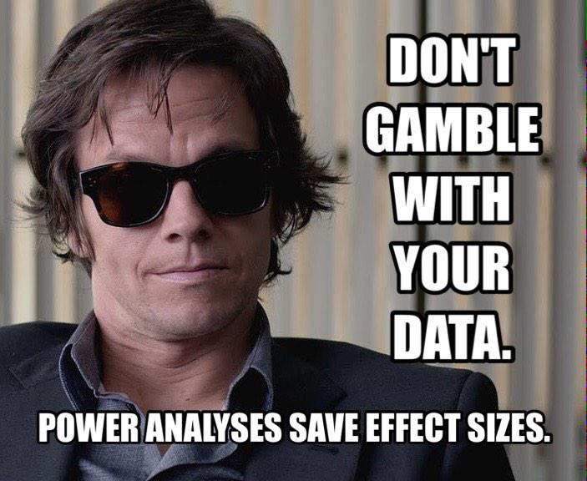

Slide 3
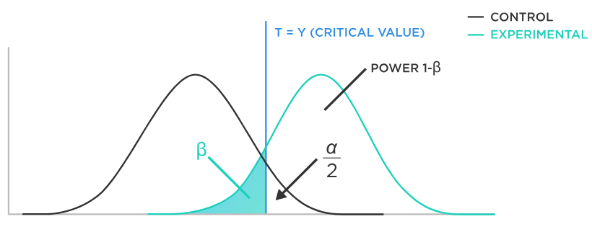
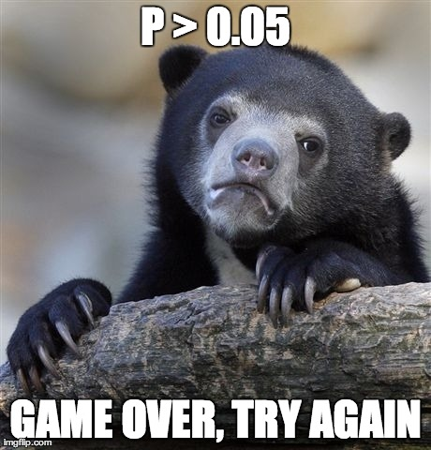
What is power?
Probability of type-2 error
Notes:
B = probability of saying two things are the same, when they are actually different
a = probability of saying two things are different when they are actually the same
You’re probably really familiar with alpha – 0.05, but how much ddo you think about B ?

Slide 5
Three components of power
Variance

Slide 6
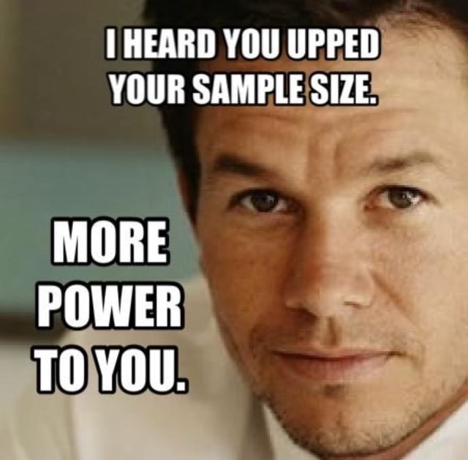
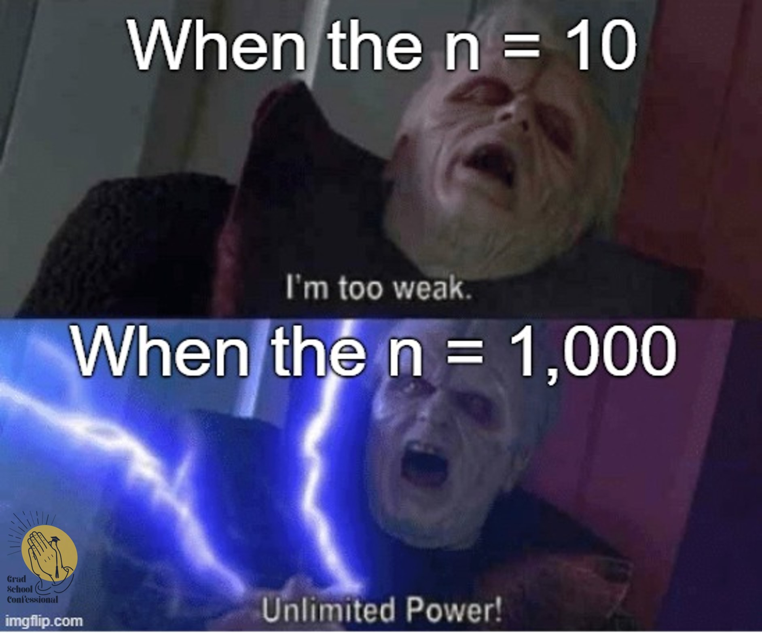
Three components of power
Variance
Sample size

Slide 7
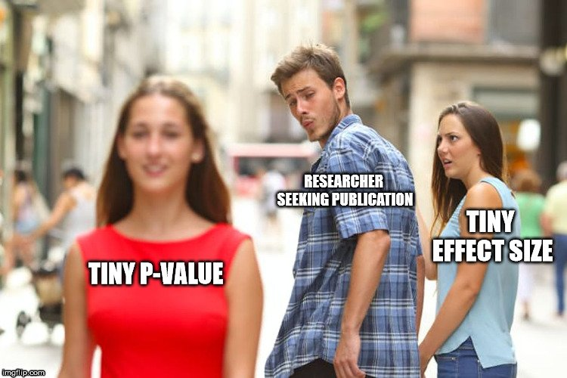
Three components of power
Variance
Sample size
Difference in means

Slide 8
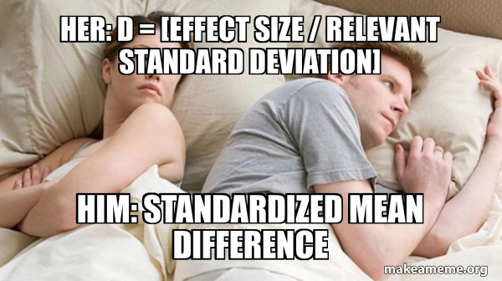
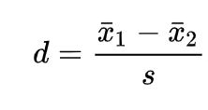
Variance + Difference = Effect Size
Cohen’s D
Standardized mean difference

Slide 9
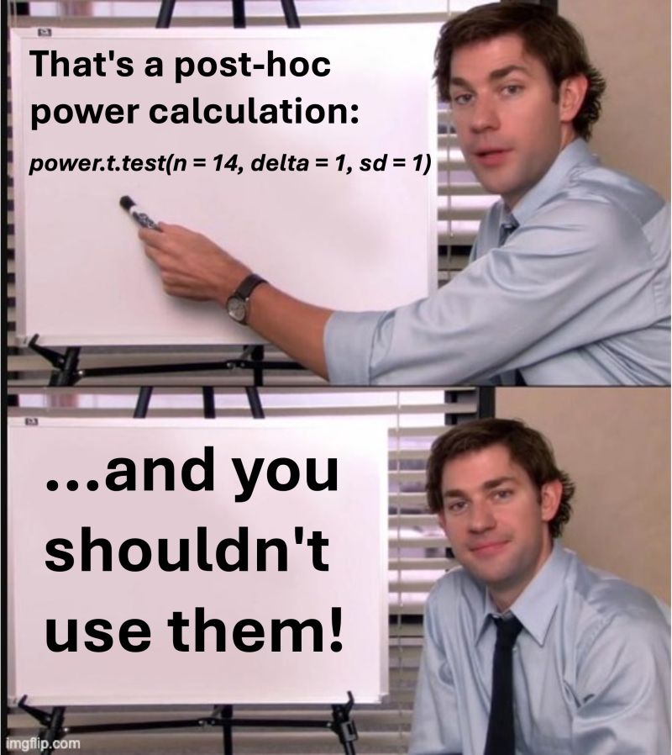
Why do I care?
I did an experiment, I didn’t get a significant difference. Did I just need more samples?
Post-hoc power analysis, not recommended.
Notes:
Some statisticians argue that post hoc power analysis is not meaningful because it assumes that the observed effect size is the true effect size in the population, which may not be accurate. Additionally, the calculated power is essentially a function of the p-value and doesn't provide new information, according to some sources.

Slide 10
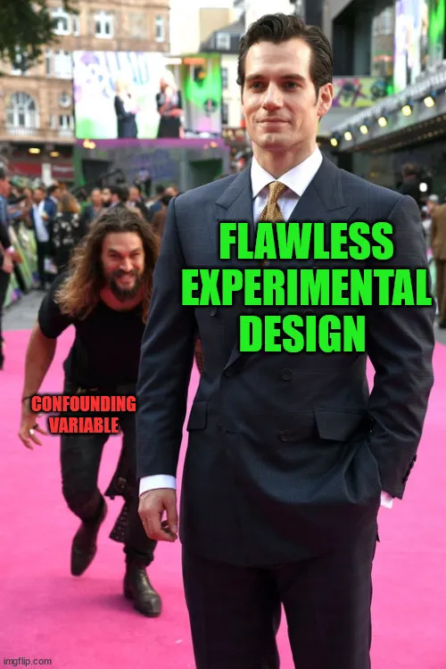
Why do I care?
I’m planning to do an experiment, how many samples do I need?
Need to decide on the variance and effect you expect.

Slide 11
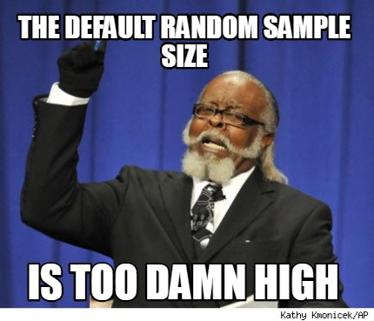
Why do I care?
I’ve been doing a lot of work, can I get away with fewer samples?
Notes:
Power analysis can be really useful in reviewing monitoring programs and stuff. That’s why I started digging into it.

Slide 12
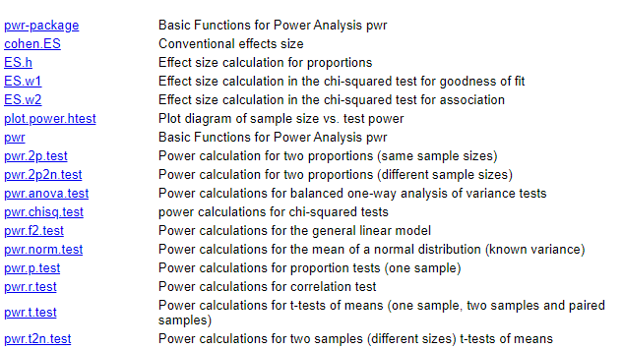
Really-basic power analysis
https://clincalc.com/stats/samplesize.aspx
Package pwr

Slide 13
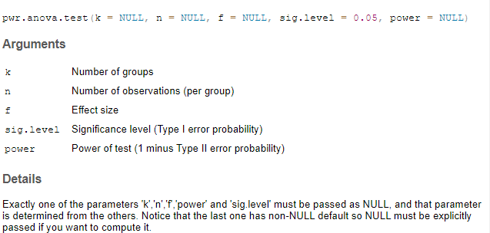
pwr.anova.test
Notes:
Similar inputs for t-tests, linear models, etc.
Just need effect size, number of observations, etc.

Slide 14
But I can’t just run an ANOVA…
glmm(Count ~ Region*Year + (1|Station) + (1|Month), family = “binomial”)
Simulation-based power analysis.

Slide 15
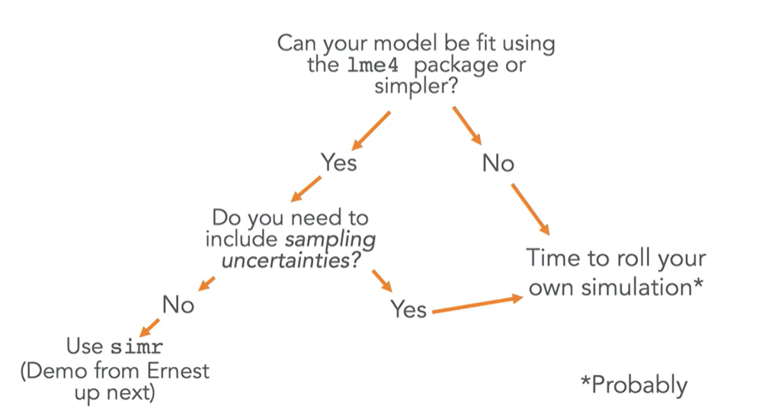
(slide ripped off from Noam Ross, R Open Sci, without permission)

Slide 16
Package simr
Make fake data with certain variance, sample size, and effect size.
Run your model 1000 times.
The number of times p<0.05 over the total number of tries is your power!

Slide 17
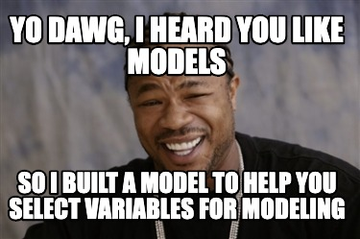
More complicated models – do it yourself
Simulate data based on your predicted variances
Run the model
Repeat ad nauseum

Slide 18
More resources
Kain M, Bolker B, McCoy M. 2015. A practical guide and power analysis for GLMMs: detecting among treatment variation in random effects. PeerJ. 3: e1226. https://doi.org/10.7717/peerj.1226
Chapter 16 of this book (Free PDF at link!): https://avehtari.github.io/ROS-Examples/ is also helpful.

