Slide 1
Graph of the Day
Pie charts and (usually) better options

Slide 2
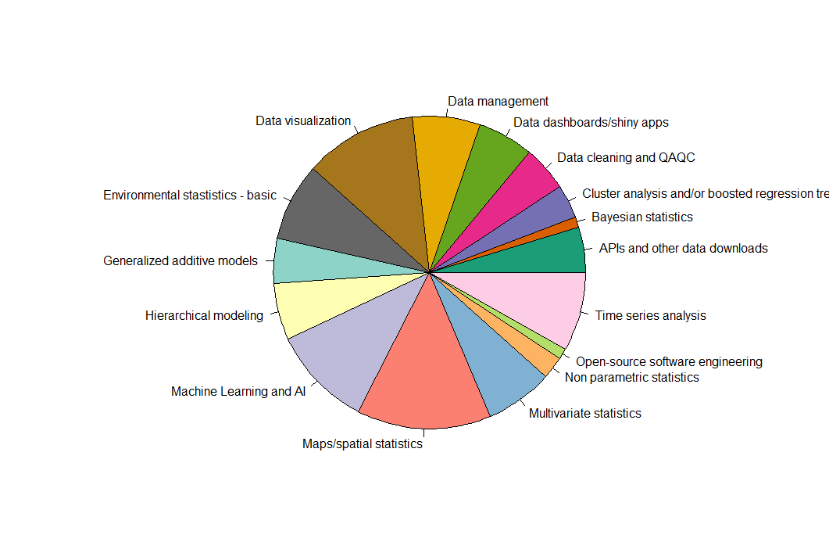

Slide 3
The code:
pie(data$N, data$group, col = mycolorpalette)
group | N
APIs and other data downloads | 4
Bayesian statistics | 1
Cluster analysis and/or boosted regression trees | 3
Data cleaning and QAQC | 4
Data dashboards/shiny apps | 5
Data management | 6
Data visualization | 10
Environmental stastistics - basic | 7
Generalized additive models | 4
Hierarchical modeling | 5
Machine Learning and AI | 9
Maps/spatial statistics | 12
Multivariate statistics | 6
Non parametric statistics | 2
Open-source software engineering | 1
Time series analysis | 7

Slide 4
The code (ggplot:
#set up labels for ggplot version of ppie chart
pi2 <- piresults %>%
arrange(desc(topics)) %>%
mutate(prop = N / sum(piresults$N) *100) %>%
mutate(ypos = cumsum(prop)- 0.5*prop )
# Basic piechart
ggplot(pi2, aes(x=2, y=prop, fill=topics)) +
geom_bar(stat="identity", width=1, color="white") +
coord_polar("y", start=0) + theme_void() +
theme(legend.position="none") +
geom_text(aes(y = ypos, label = topics), size=3) + scale_fill_manual(values = mypal, guide = NULL)+
theme_void()+ xlim(c(0,5))

Slide 5
Labels are hard.
One of the few cases where it might be easier in base R

Slide 6
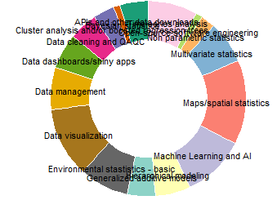
But you can make donut plots!

Slide 7
Why use a pie chart?
Format people are used to
They look cool
Intuitively know it is a piece-of-a-whole

Slide 8
Why not use a pie chart?
Take up a lot of space
Hard to compare sizes of slices
Hard to see small values

Slide 9
Bar chart
Much easier to compare groups.
Not as easy to compare groups to the whole.

Slide 10
Code
ggplot(piresults, aes(x = topics, y = N, fill = topics)) +
geom_bar(color = "grey29", stat = "identity")+
theme_bw()+
theme(axis.text.x = element_text(angle = 90, hjust =1, vjust = 0.5))+
scale_fill_manual(values = mypal, guide = NULL)

Slide 11
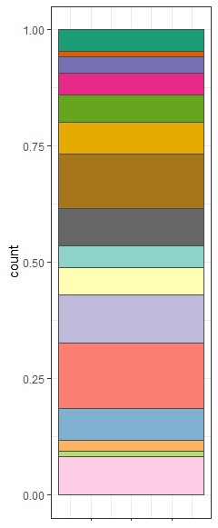
Stacked bar chart
Easier to see percentage of the whole
Better than pie chart for comparing size of slices
May be biased by order of groups.

Slide 12
Code
ggplot(piresults, aes(x = 1, y = N, fill = topics)) +
geom_bar(color = "grey29", stat = "identity“, position = “fill”)+
theme_bw()+
theme(axis.text.x = element_text(angle = 90, hjust =1, vjust = 0.5))+
scale_fill_manual(values = mypal, guide = NULL)

Slide 13
Questions?

Slide 14
Now a note on the actual poll results….
Data Vis
Maps/spatial stats
Machine learning
Time series
Basic Stats

Slide 15
Now a note on the actual poll results….
Data vis – new Graph of the Meeting series
November meeting – Basic stats/beginner day? Or Machine learning/time series?
Feb meeting – Maps
  Basic maps in R - Rosie
  Cartography intro – Celeste
  Rasters and remote sensing data – Shruti
  Cool hill shading trick – Eric H.
  Any other volunteers?

Slide 16
